Slide 1

COURSE : OBJECT ORIENTED PROGRAMMING LANGUAGE
COURSE COORDINATOR : N.VENKATA RAMANA SIR
TITLE OF THE PROJECT : RESERVATION MANAGEMENT SYSTEM
LIST OF DEVELOPERS : A.SOMINI
C.LOUKYA
A.HARSHA VARDHINI
K.VARSHA
I.VAISHNAVI

Slide 2

BRIEF ON PROJECT
Reservation Management System using Java.
In this system allows you to make reservations for guests in online mode.
Online reservation systems have become increasingly popular in recent years, as more and more businesses look to streamline their booking process and provide a more convenient experience for their customers.
In this blog, we will discuss how to build an online reservation system using Java.
The online reservation system we will build a simple console-based application that allows users to make, view, and cancel reservations.
For businesses, online reservation systems offer a number of benefits, including increased efficiency, reduced workload, improved customer experience, and the ability to manage and monitor reservations in real-time.

Slide 3
FEATURES OF PROJECT:
In this we can allow users to make reservations for available resources, modify or cancel their reservations , confirmation or payment processing and Sends automated notifications and remainders to users about their reservations .
It Provides support for multiple languages and currencies to cater to diverse user requirements .
Allows administrators to manage resources or services, such as
Adding,
Updating or
Deleting resources,
Setting availability and
Managing pricing.
It may include features such as email notifications, SMS alerts, and in-app notifications.

Slide 4

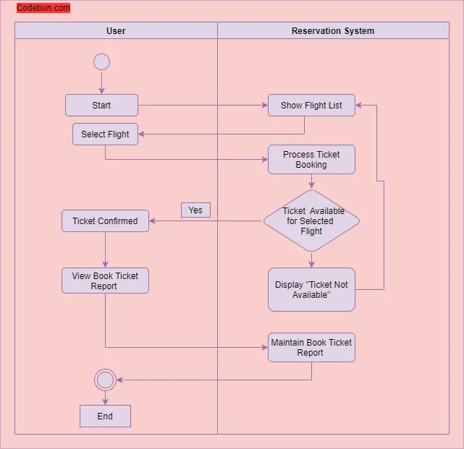

Slide 5

LIST OF CLASSES USED IN THIS PROJECT:
Reservation
Reservation Manager
Reservation Management System
LIST OF METHODS USED IN THIS PROJECT:
get ReservationId()
get PassengerName()
get FlightNumber()
get SeatNumber()
Confirm Reservation()
Cancel Reservation()
Add reservation()

Slide 6

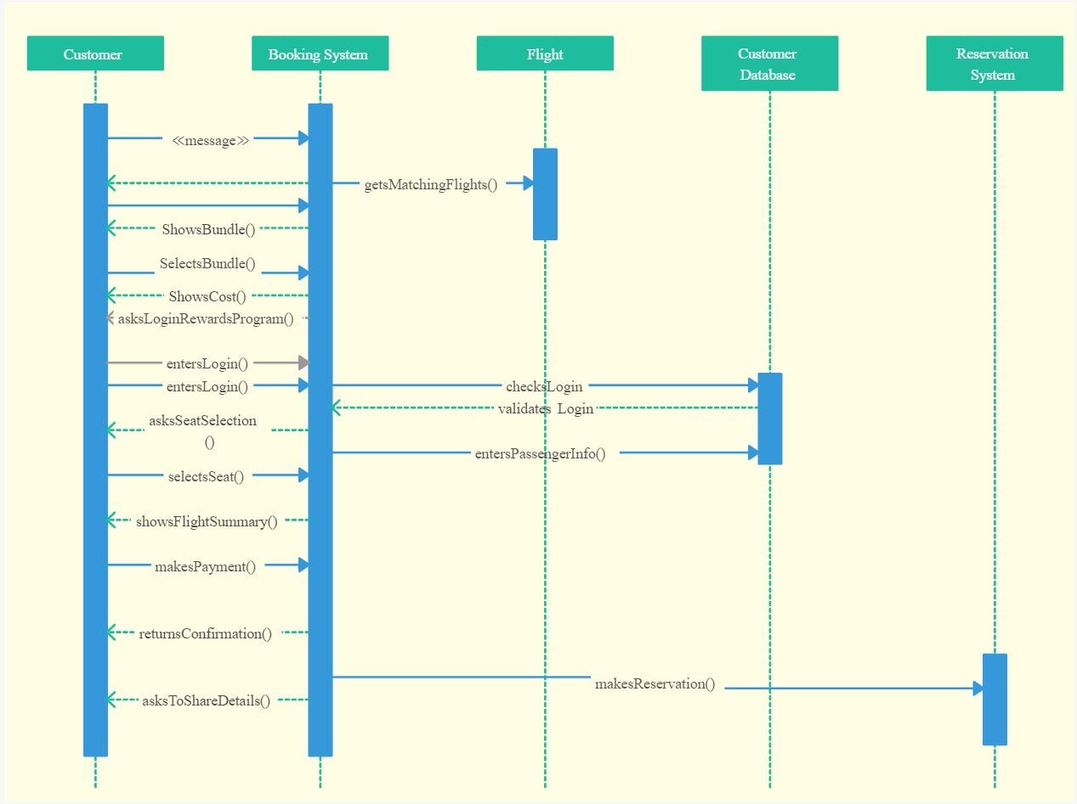

Slide 7
INTERFACES OF JAVA ON RESERVATION MANAGEMENT SYSTEM:
Airline reservation System is a computerized system used to store and retrieve information and conduct transactions related to air travel.
This software has two parts.
First is user part and the administrator part.
User part is used as a front end and administrator is the back end.
It will allow the customers to access database and allow new customers to sign up for online access.
The system displays all the flight’s details such as flight no, name, price and duration of journey etc.After search the system display list of available flights and allows customer to choose a particular flight.
Then the system checks for the availability of seats on the flight.
If the seats are available then the system allows the passenger to book a seat.
Otherwise it asks the user to choose another flight.

Slide 8
ROLES AND RESPONSIBILITIES
A.Somini :
Guiding the team members
Determine what needs to get done
Meet to discuss priorities on an ongoing basis
Understand your team’s strengths
C.Loukya:
selecting the information they need to solve problems or complete tasks.
break down tasks into steps and put information in order,
Find approach to the problem from another direction.
A.Harsha Vardhini:
Deal well with distractions focused .
Find information and are proactive about doing so.
Task oriented and ask for advice or input when they are stuck on problem.

Slide 9
K.Varsha:
work well with other people and listen to their suggestions.
like to check that they have understood problems, and suggest different ways of solving them in a team.
They can follow instructions to get tasks done and see how these contribute to overall team goals.
I.Vyshnavi
The planner plans the time commitments of the team and makes sure it is aligned with the needs of customers.
advises the team of upcoming plans and any anticipated changes.
monitors team productivity.
This includes summaries of work delivered, and reports .

Slide 10
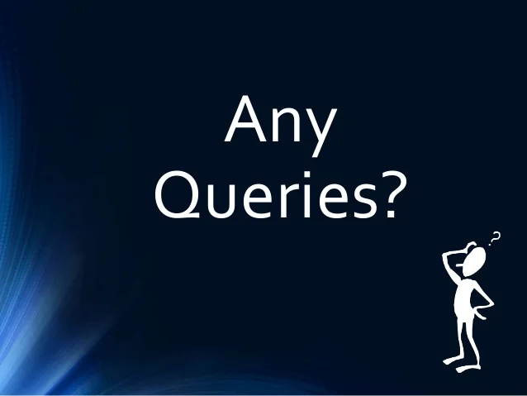

Slide 11


